Slide 1
Project Presentation of CO-OP Project at Industry (Module-2) (22CS421)
On
CHATHIVE: Real-Time Chat-Application
Abhishek(2210991164)
Kashish Girdhar(2210991767)
Kashish Barthwal(2210990495)
Arnav Jain (2210991349)
Supervised By
Dr.Shyam Goyal
Department of Computer Science and Engineering,
Chitkara University, Punjab

Slide 2
Introduction
ChatHive is a full-stack real-time chat application designed to provide seamless and instant communication between users through a web-based platform. In today’s digital era, fast and reliable messaging systems are essential for personal, professional, and collaborative interactions. This project focuses on building a secure, scalable, and responsive chat system using modern technologies such as React.js for the frontend, Node.js and Express for the backend, and MongoDB for data storage. By leveraging Socket.IO for real-time bidirectional communication, ChatHive ensures instant message delivery without delays.
‹#›

Slide 3
Problem Statement
In modern communication systems, users expect instant and reliable messaging, but traditional web applications based on HTTP protocols often introduce delays due to their request-response nature. Additionally, many existing chat platforms struggle with scalability, secure authentication, and efficient storage of large volumes of messages and media.
Traditional HTTP-based systems cause delays in messaging
Difficulty in achieving real-time communication
Challenges in secure user authentication
Inefficient handling of chat data and media storage
Need for a scalable and responsive chat application
‹#›

Slide 4
Execution of Project
FRONTEND: React.js, Tailwind CSS
BACKEND: Node.js, Express.js, MongoDB, Sockets
SECURITY: JWT Authentication, HTTPS, Secure Storage Practices, Cookies
File Handling: Cloudnary.js
‹#›

Slide 5
Key Learnings
Real-Time Communication: Learned how to implement instant messaging using Socket.IO and WebSockets.
Full-Stack Development: Gained experience in integrating frontend, backend, and database systems.
Authentication & Security: Understood secure login systems using JWT, cookies, and HTTPS practices.
Database Management: Learned to design and manage NoSQL databases like MongoDB for chat data.
API Development: Built and tested RESTful APIs using Node.js and Express.js.
Cloud Integration: Implemented Cloudinary for efficient image storage and delivery.
Error Handling & Debugging: Improved ability to handle runtime errors and debug applications.
‹#›

Slide 6
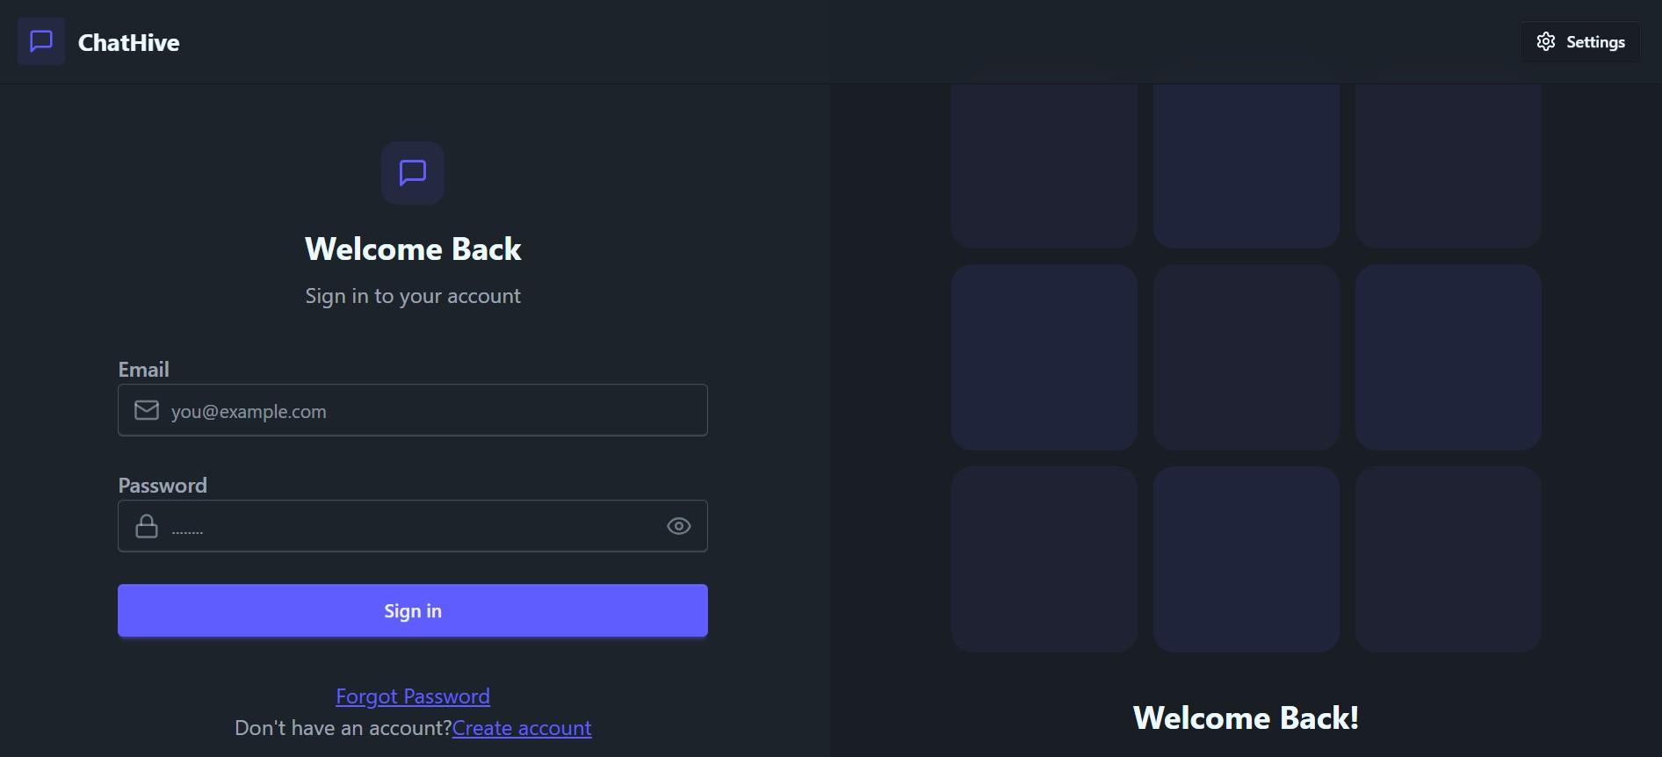
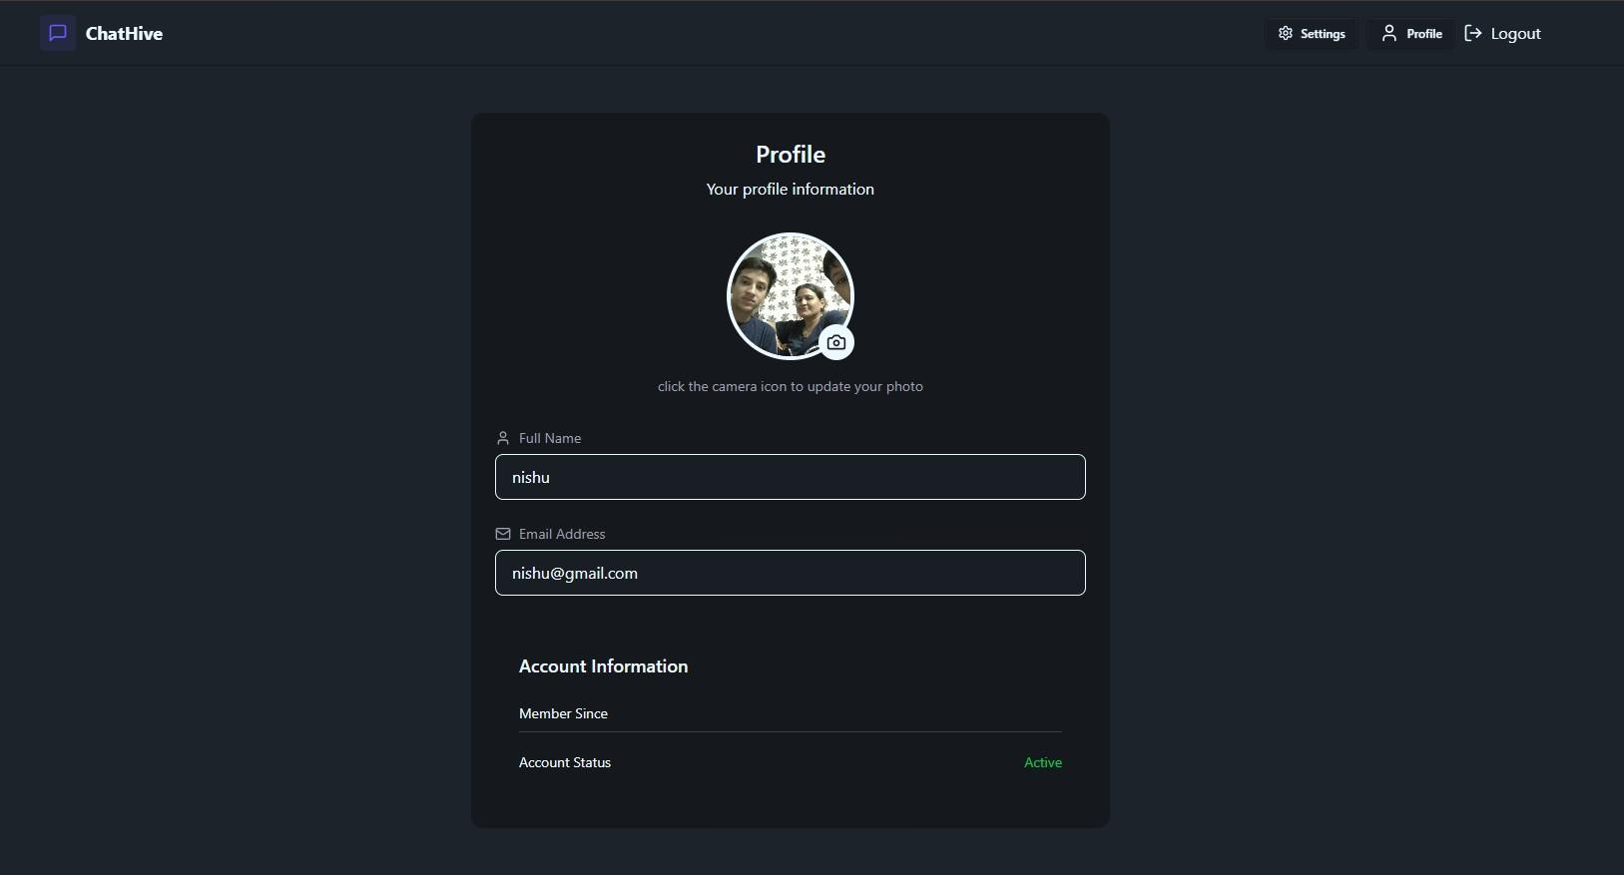
Snapshots
‹#›

Slide 7
Conclusion
Successful Implementation: Developed a fully functional real-time chat application with core features.
Real-Time Performance: Achieved instant messaging using Socket.IO for seamless communication.
Secure System: Ensured data protection through authentication and secure practices.
Scalable Architecture: Built a system capable of handling multiple users efficiently.
Enhanced User Experience: Delivered a responsive and interactive UI for smooth usage.
‹#›

Slide 8
Thank You
‹#›

